Slide 1
Ａｒｔ Olympia 2015 -from Art Olympia to the world- sponsored by：Art Olympia Executive Committee, Yamaguchi Artist Support, Living National Treasure Museum cooperated by : Toshima City,Tokyo
*All the items mentioned are subject to change.

Slide 2
We are proudly announcing a new open art competition “Art Olympia”, which we consider to be an important platform for talented and emerging artists.
(1) CONNECT
First of all, we would like to establish a worldwide hub of art and culture which would meet and connect domestic artists to a whole new level.
By introducing artists through the Art Olympia, we aim to expand their opportunities to flourish in their art carrier from their limited environment to infinite boundaries.
(2) DISCOVER
Secondly, we would like to discover the future of global artists. The Art Olympia will collect artworks from all over the world and invite domestic and foreign art experts as jurors.
A variety of jurors from different cultural and historical background enable us to broaden the possibility to discover talented artists.
(3) CREATE
Lastly, it is our passion to encourage and to inspire artists creating a next generation art and a new aesthetic sense of beauty.
We believe the exchange of culture will stimulate artists to expand beyond their borders.
-from Art Olympia to the world-

Slide 3
Art Olympia is an international open art competition held biyearly.
This new and recent project is to encourage and support talented and promising artists,
to help them advance in their careers and maximize their exposure to the world.
Art works will be evaluated by a grading system and selected by ‘first-class fine arts’ competition jurors.
This competition is open to everyone, regardless of nationality or gender.
We will establish additional bases in NYC and Paris in this first Art Olympia, and will collect artworks from all over the world.
Art Olympia is …

Slide 4
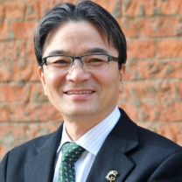
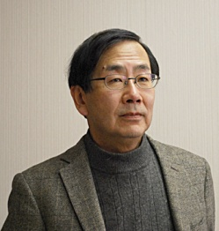
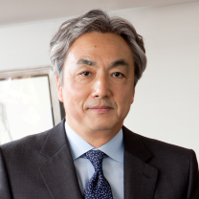
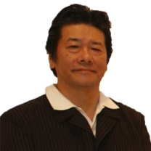
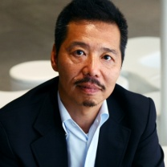
Jurors
The chief juror
Ryohei Miyata
The president of Tokyo University of the Arts.
Councilor of Nitten. Director of Modern Crafts Arts Association. Research Fellow at Museum Furkunst und Gewerbe, Hamburg, under the Japanese government overseas research program since1990. The President of Tokyo National University of Fine Arts and Music (2005).
Akira Tatehata
Director of the National Museum of Art, Osaka Japan. Curator of the National Museum of Art, Osaka.
Professor of Tama Art University from 1995 to 2005.
Japanese commissioner for the Venice Biennale (1990, 1993).
Art director of Yokohama Triennale (2001).
A poet, received Rekitei Prize of New Poet (1991) and Takami Jun Award (2005).
Hiroshi Senju
Painter
The president of Kyoto University of Art & Design from 2007 to 2013.
Professor of Kyoto University of Art & Design.
Director of Koyodo Museum.
President of joint education system of Kyoto University of Art & Design and Tohoku University of Art & Design.
Member of masters committee of L'ÉCOLE of Van Cleef & Arpels. Advisor of The Tokugawa Museum.
Hiroshi Minamishima
Professor of Joshibi University of Art and Design and the former Director of Contemporary Art Museum,Kumamoto.
Graduated from the School of Art and Design, University of Tsukuba.
Founding staff member of Iwaki City Art Museum and the Hiroshima City Museum of Contemporary Art.
Founding director of the Contemporary Art Museum, Kumamoto (CAMK).
Co-curators of the International Triennale of Contemporary Art (ITCA) 2008.
Yuji Akimoto
Director of the 21st Century Museum of Contemporary Art since 2007.
Operation manager of museums for Benesse Holdings, Inc from 1991 to 2004.
Director of the International Triennale of KOGEI in Kanazawa.
Photo by CHISATO HIKITA

Slide 5
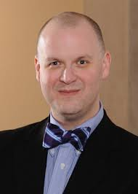
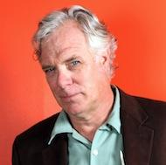
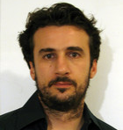
Jurors
Eric C. Shiner
the Director of The Andy Warhol Museum, the most comprehensive single-artist museum in the world. Shiner is a scholar of contemporary Japanese art and a leading authority on Andy Warhol
Brett Littman
Executive direcotr of The Drawing Center since 2007.
Former deputy director of MoMA PS1 from 2003 to 2007.
Art an design critic, member of AICA/USA (International Art Critic Association).
Gregory Amenoff
Painter
a professor of Columbia University
the recipient of numerous awards from organizations including the American Academy of Arts and Letters
Kara Vander Weg
an exhibition coordinator at Gagosian Gallery in Manhattan, where she also manages artists, including John Currin and Walter De Maria. She graduated from Northwestern and has a master’s in art history from Williams.
Nicolas Touron
multi-media artist.
professor at School of Visual Arts NY

Slide 6
Judging
Qualifications＆Conditions
【Accepted Media】
2-Dimensional Work: oil, watercolor, acrylic , charcoal, graphite, pastel.
（photography is not accepted）
【Eligibility】
All Nationality and Gender.
All artists 18 or older.
Those who intend to advance in their art careers, aiming at becoming professionals.
Student IDs required for the “Student Awards ”.
This competition is for individual artists.
【Entry Fee】
General:$60 for 1image, $ 100 for 2images, $ 140 for 3images (max 3)
Students:$40 for 1image, $70for 2images, $ 100 for 3images (max 3)
Students can get discount with submitting IDs 【Guidelines】
All works must be the original art that have never been submitted to other competitions.
An artwork should be no larger than 117x117 centimeters (46x46 inches), and there is no minimum size.
All artwork must be framed or stretched, adequately wired and ready to hang.
First round
The first round will be held at every base (NYC,Paris,Tokyo).
In NYC and Paris, the jurors will evaluate all entries as digital images.
In Tokyo, the jurors will evaluate the actual artworks.
Final round
The final round will be held in Tokyo, with the collection of actual art works.
We will invite international jurors for final round from each base.
Jurors will do the final evaluation and deterimine the awards.
Evaluating system
Each artwork will be evaluated and graded by each juror,
and compete for ranking by the sum of total points.
The artwwork which gets highest score will take the 1st prize.
Special Prizes will be awarded to the works in which each juror and each member of executive committee selects as the best.

Slide 7
General Awards
Student Awards
Gold Prize | $120,000 Trophy,exhibition, art magazine article artist’s name and the work
Silver Prize | $30,000 Trophy,exhibition, art magazine article artist’s name and the work
Bronze Prize | $20,000 Trophy,exhibition, art magazine article artist’s name and the work
4th prize | $3,000,exhibition, art magazine article(artist’s name only)
5th prize | $2,000,exhibition, art magazine article(artist’s name only)
6th prize | $1,000,exhibition, art magazine article(artist’s name only)
Special Prize from juror (about for 15) | $1,000,exhibition, art magazine article(artist’s name only)
Fine works（for 40） | $700,exhibition, art magazine article(artist’s name only)
Selected works（about for 120） | All artists selected to final round will accept ＄500 (except winners of the above-mentioned prize)
Gold Prize | $20,000 Trophy,exhibition, art magazine article artist’s name and the work
Silver Prize | $10,000 Trophy,exhibition, art magazine article artist’s name and the work
Bronze Prize | $5,000 Trophy,exhibition, art magazine article artist’s name and the work
4th prize | $3,000,exhibition, art magazine article(artist’s name only)
5th prize | $2,000,exhibition, art magazine article(artist’s name only)
6th prize | $1,000,exhibition, art magazine article(artist’s name only)
Special Prize from jurors (about for 15) | $1,000,exhibition, art magazine article(artist’s name only)
Fine works（for 10） | $700,exhibition, art magazine article(artist’s name only)
Selected works（about for 30） | All artists selected to final round will accept $500 (except winners of the above-mentioned prize)
*Students can win both awards, general awards and students awards.

Slide 8
Schedule
9
10
11
12
1
2
3
4
５
６
Tokyo
Website opens
2/2～4/17
Call for entries
2/2～4/17
Each applicant will send their actual art pieces
5/30・5/31
1st round Judging
6/10
Final round
And Reception party in Tokyo
6/11～6/30
Exhibition in Tokyo
New York
Call for entries
The finalists will ship their works to Japan
1st round Judging
English website opens
～●/●
The finalists will ship their works to Japan
Paris
Call for entries
1st round Judging
The finalists will ship their works to Japan
*The schedule details of New York and Paris is not finalized.

Slide 9
Organization
Art Olympia Executive Committee
Living National Treasure Museum
Manazuru Art Museum
Yamaguchi Artist Support
jurors
Art Olympia Executive Committee
 | name | profile
The head of Committee member | Nobuhiro Yamaguchi | Businessman. the founder of Art Olympia and the owner of the Living National Treasure Museum.
Committee member | Satoru Kitago | Sculptor.Trustee (Research)／Professor of Tokyo Univerisity of the Arts. He was awarded Ｔhe First Constantine Brancusi "Encouragement" Prize in 2003.
Committee member | Katsuki Yokoyama | President of Joshibi University of Art and Design and Joshibi junior college of Art and Design.
Committee member | Toyomi Hoshina | Professor,Dean of The Faculty of Fine Arts of Tokyo Univerisity of the Arts.
Committee member | Yoshiyuki Yabe | Director of Living National Treasure Museum. China and tea ceremony historians,awarded the 9th tea culture from the URASENKE award in 2011. Privious chief of Tokyo National Museum Ceramics office.
Committee member | Shinichi Hara | Associate professor of Sculpture of Tokyo Univerisity of the Arts.

Slide 10
About
Living National Treasure Art Museum
The Living National Treasure Art Museum in Yugawara Town in Kanagawa Prefecture has been the home of several original art creations of intangible cultural property.
The remarkable collections of various original fine arts such as ceramic arts, lacquer wares, gold works, dolls and many precious art pieces are displayed
and portray the beauty of Japan and its cultural arts.
At the aftermath of the devastating Tohoku Earthquake, the Living National Treasure Art Museum started the project of the traveling museum, which spreads to many locations throughout Japan reaching out especially to schoolally school children, requiring no fee to view the rare & rich beauty of the Art Collections, thus bringing some joy and hope to many people.

